Slide 1
Whatever you always wanted to know about the ¹³C chemical shift but were too afraid to ask!

Slide 2
How accurately can the ¹³C chemical shift be calculated at present (2023)?
We remember a value
of about 2 ppm!

Slide 3
What external factors does the ¹³C chemical shift depend on?
Solvent
Temperature
Concentration

Slide 4
What ranges can be found in the literature?
From compounds used by CSHESHIRE (CHESHIRE Chemical Shift Repository): the largest range found was 2,24ppm*
From 3 publications dealing with impurities in NMR solvents a maximum range was found at 11.94 ppm (!!!)
For the second case the most values for the range are between 0.34 and 2.34 ppm (see next slide)
* 2,41 ppm for ¹H

Slide 5
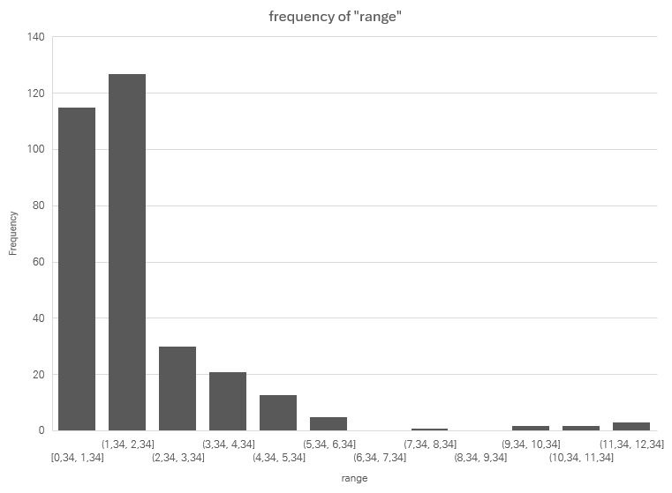

Slide 6
First Conclusion:
An accuracy of 2 to 2.5 ppm
seems acceptable,
especially when relying
on literature data.

Slide 7
Switching to ab-initio calculation of ¹³C chemical shift

Slide 8
Two fields to examine more closely
Geometry optimization is the more time-consuming step in these calculations. What influence does geometry have on results with acceptable accuracy among the results?
Which calculation method is better for the final conversion of the anisotropic shielding into the ¹³C chemical shift? The use of a reference substance like TMS or a regression method as described by Tantillo et al.?

Slide 9
Sources and Tools:
patonlab/CASCADE: CAlculation of NMR Chemical Shifts using Deep Learning
NMR8K.sdf contains 79xx molecules with ¹H and/or ¹³C spectra compiled from NMRSiftDB2 (76 random compounds was used)
DFT-geometrien.sdf contains the most of the compounds optimized with UB3LYP/6-31G(d) (73 compounds was used)
pyscf and gpu4pyscf - a python module for quantum chemistry and a version for usage on NVIDIA gpu‘s using CUDA 11.x or CUDA 12.x
rdkit/rdkit: The official sources for the RDKit library
Jupyter notebook on PC and HPC- Cluster

Slide 10
Testcase 1: UFF geometries / ab- initio shieldings
Geometry optimisation: Universal forcefield as implemented in rdkit
NMR: Shieldings using pyscf and B3LYP/6-31G*
Calibration
CSHESHIRE without Solvent
… with CDCl3 and method SMD
… with CDCl3 and method CPCM/UAKS
Using TMS as reference
Results are directly stored into a excel-sheet

Slide 11
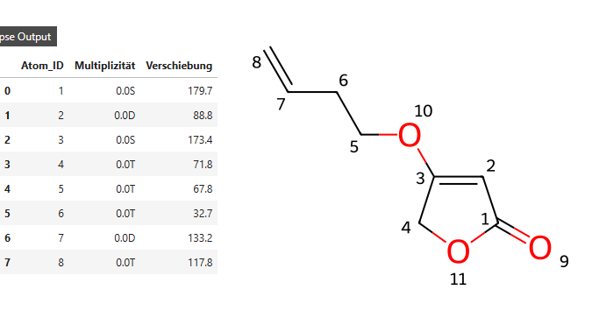
step one: read data

Slide 12
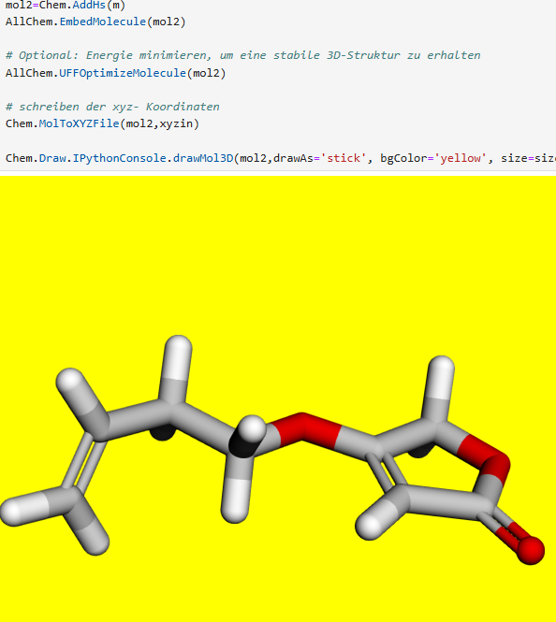
Step two: generating 3D coordinates
Optimize geometry

Slide 13
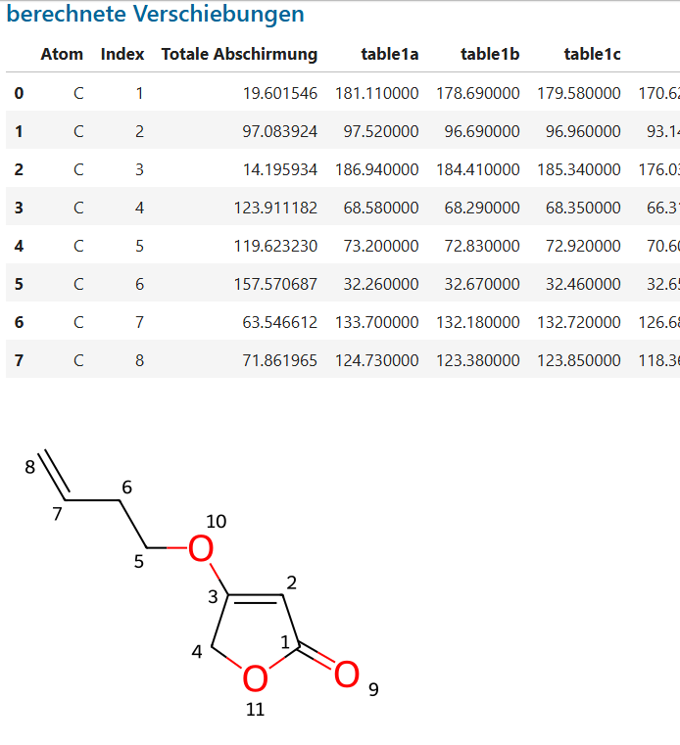
Step three: visualisation of results

Slide 14
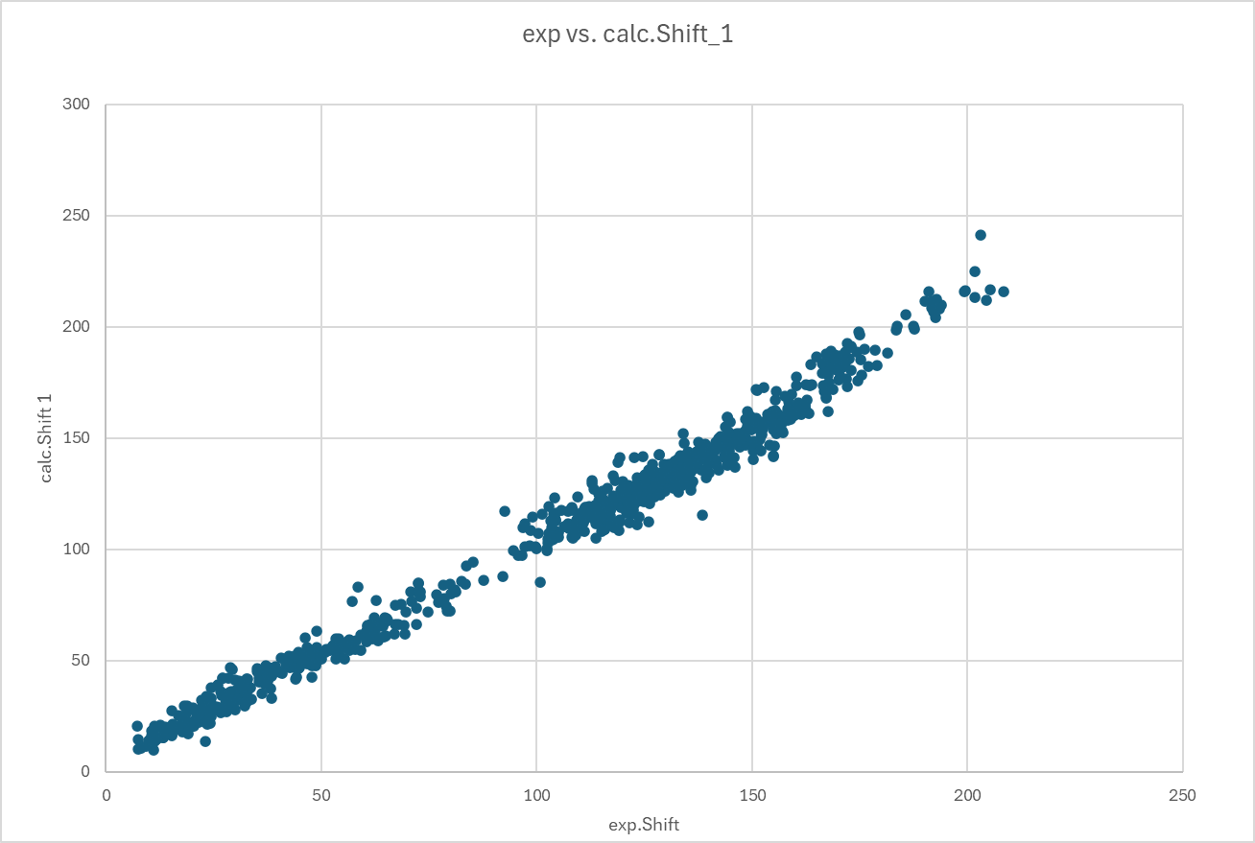
Results - 1

Slide 15
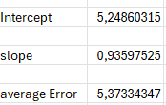
Results-2 (TMS)

Slide 16
Testcase 2: MMFF geometries / ab- initio shieldings
Same procedure using Merck Forcefield
Adding more atom descriptors (986 atoms):
Hybridisation
Direct bonded S (32),Cl (11),Br (0)
Is chiral? (information is lost)
Is aromatic? (468)
Gasteiger-Charge

Slide 17
Results-1 (regression method):

Slide 18
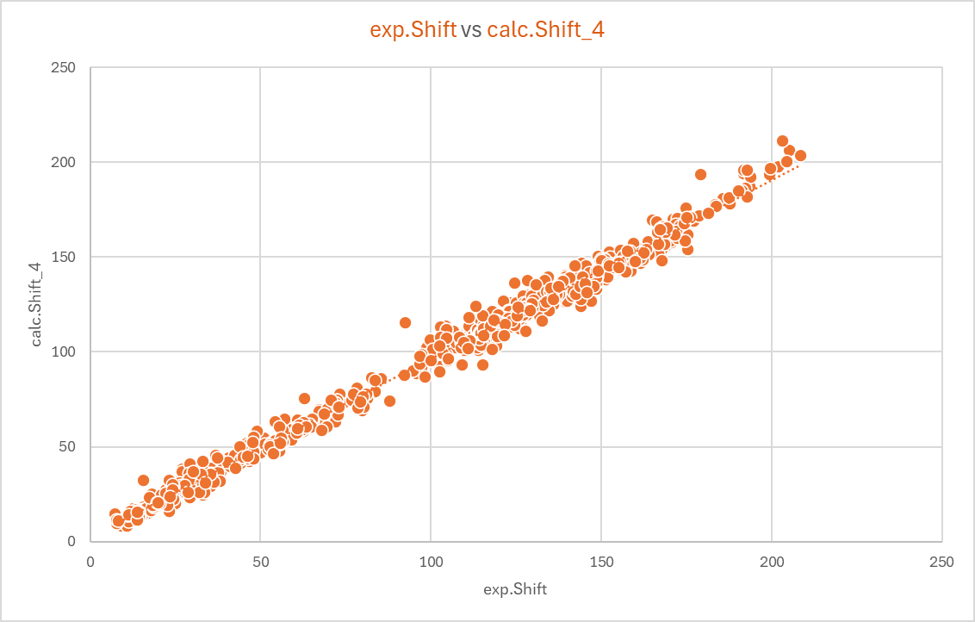
Result-2 (TMS calibration)

Slide 19
Results seaparated by hybridisation

Slide 20
What we learn?
The calibration using TMS is significantly worse than that using the regression model.
For both methods, the results for sp-hybridized carbon atoms are the least accurate. However, these atoms are also significantly rarer.
The calibration using TMS works best with sp3-hybridized carbon atoms.
Whether it is beneficial to calibrate sp2-hybridized carbon atoms, for example, against benzene and sp-hybridized carbon atoms against an alkyne?
Does it make sense to design a separate regression model for each hybridization state?

Slide 21
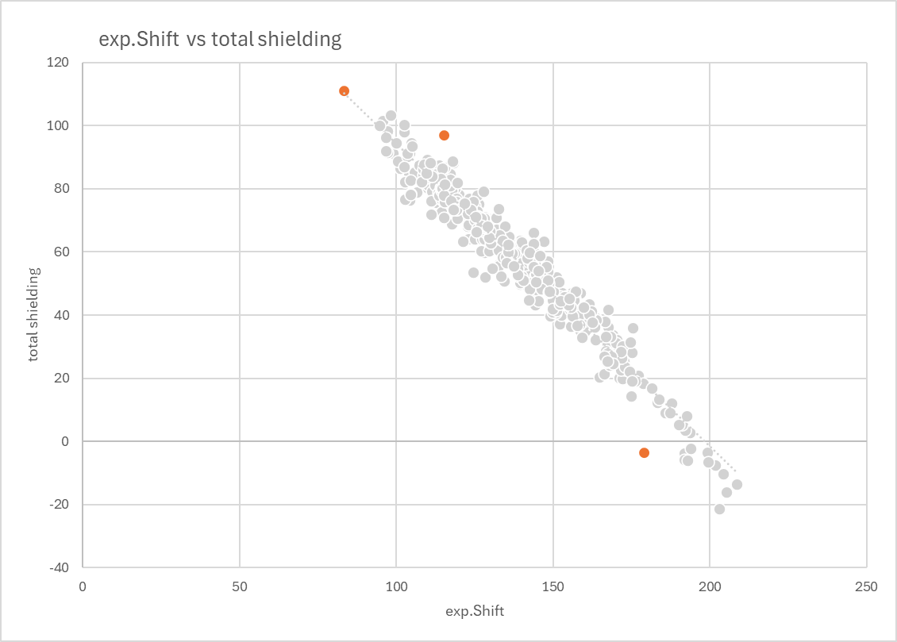
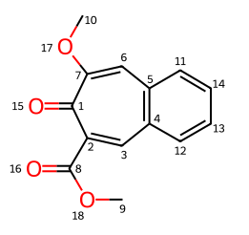
Example: sp2-hybridisation (exp. Shift vs. Total shielding)

Slide 22
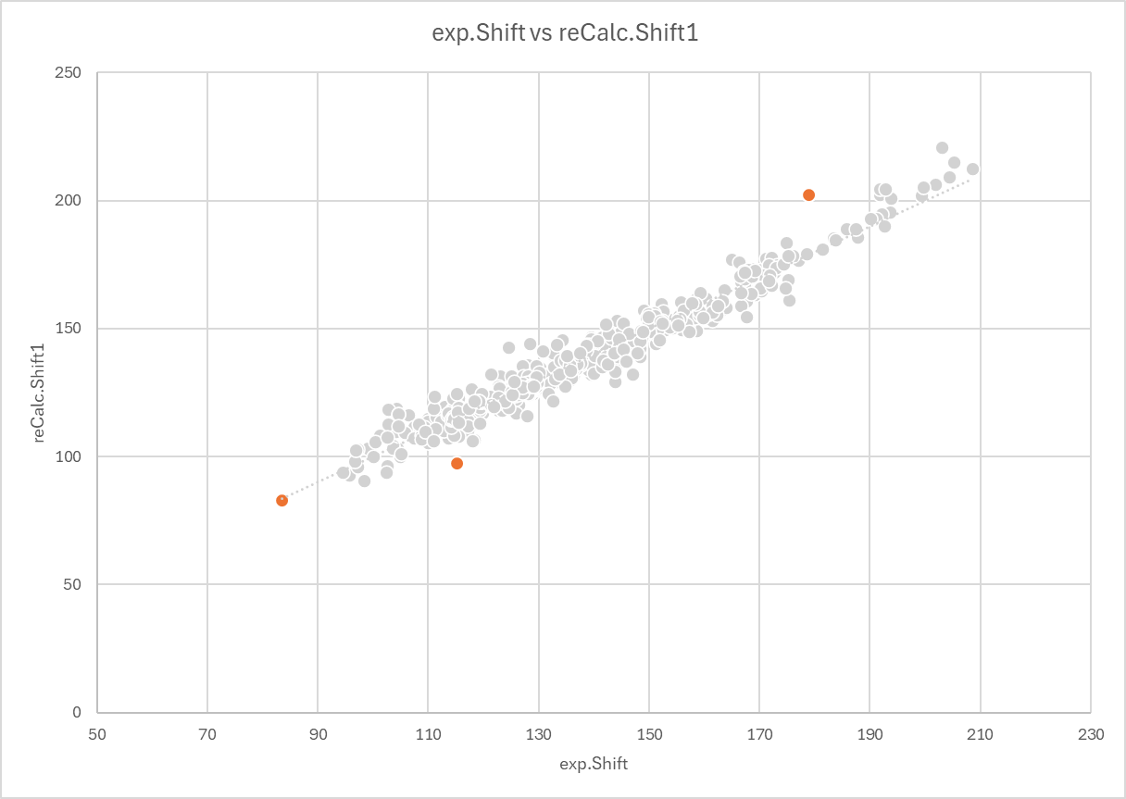
Example: sp2-hybridisation (exp. Shift vs. reCalculated shifts using regression)

Slide 23
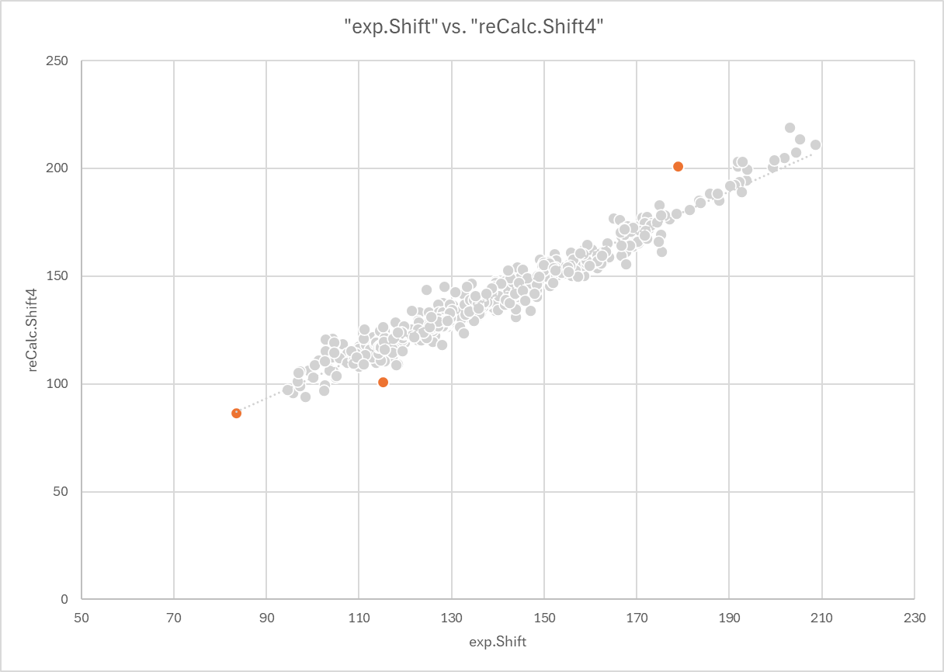
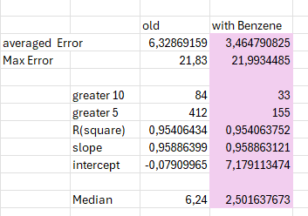
Example: sp2- hybridisation using benzene as reference
Using benzene as reference
Is definitivly better than TMS.

Slide 24
Testcase 3: DFT geometries / ab- initio shieldings
Same procedure as before
Geometries come from CASCADE
3 geometries was not found

Slide 25
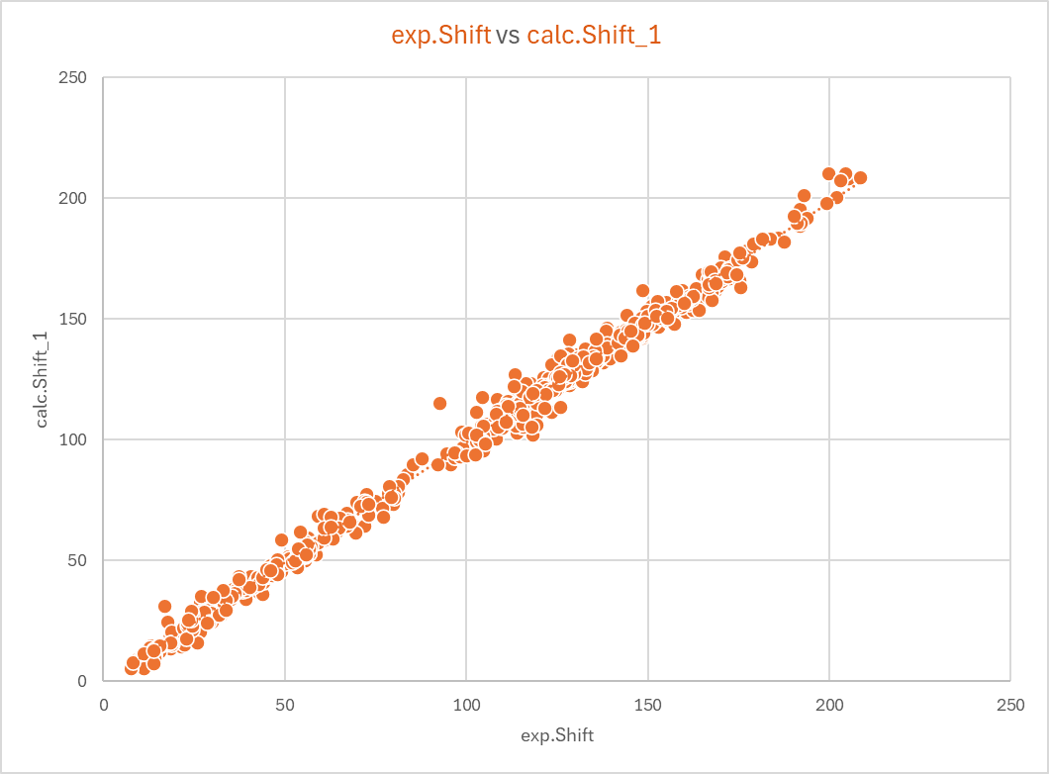
Results-1 (regression method):

Slide 26
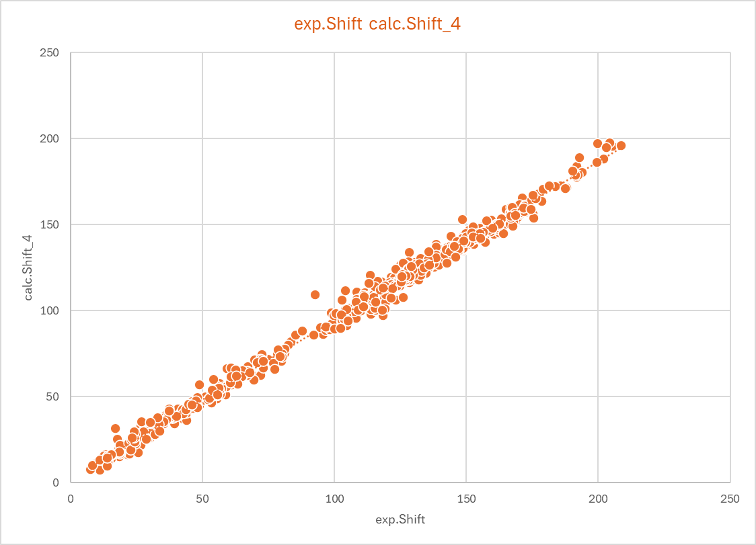
Result-2 (TMS calibration)

Slide 27
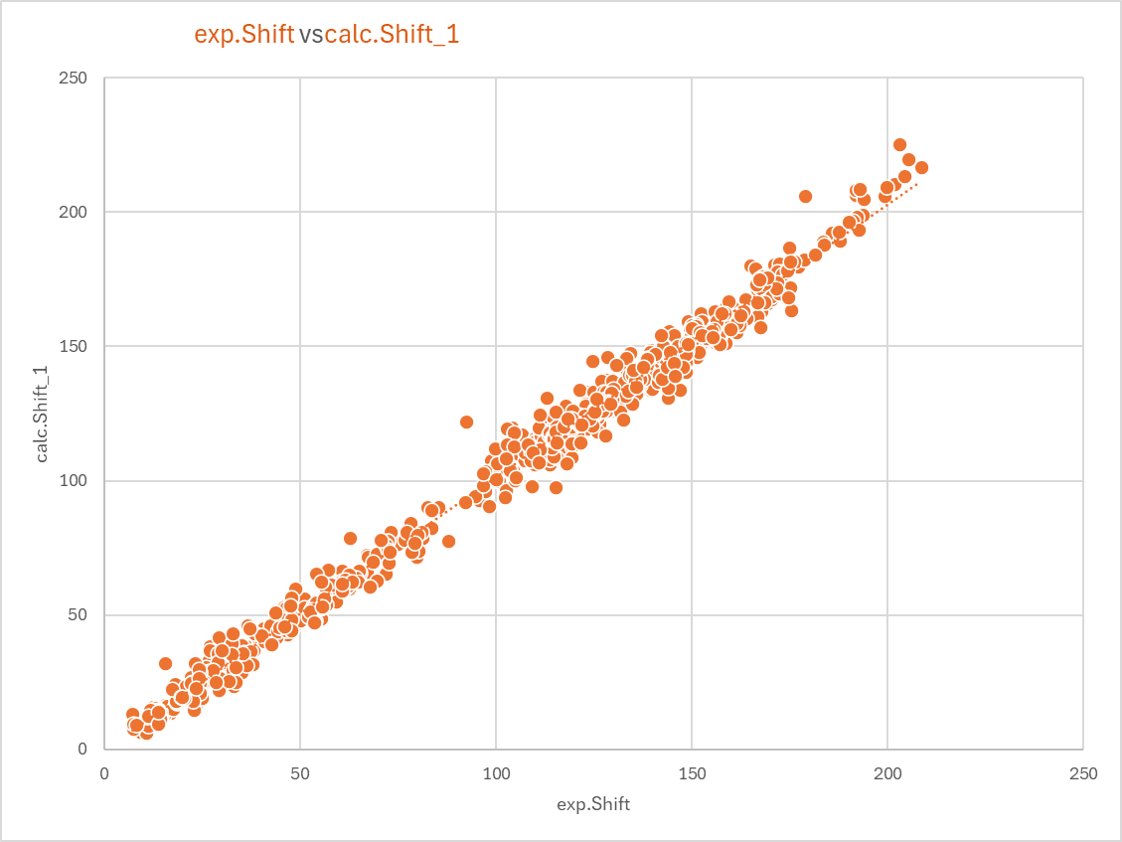
MMFF vs. Ab-Initio Geometries
MMFF
Ab- Initio

Slide 28
MMFF vs. Ab-Initio Geometries
MMFF
Ab- Initio

Slide 29
Summary
The accuracy of reported ¹³C- data is often in the range of 2.5ppm.
The averaged error using MMFF geometries is 3.47ppm for ab- initio geometries 2,82ppm
The Median for the MMFF case is 2.44 ppm and the DFT case 2.21ppm
In the MMFF case i found 244 erros greater 5ppm, in the DFT case 134
A separation by degree of hybridization can bring slight improvements.
Since ab initiatio geometry optimizations take significantly longer. Whether this significantly affects the quality of assignments needs to be verified.
Another question is whether a reduction in geometry optimization time is possible through less strict convergence criteria.
The use of TMS for the calibration of ab initio calculations is significantly worse than the use of regression models.

Slide 30

Many Thanks

